Slide 1
Position Control of a DC Motor using P and PI Control
Brian Mitchell, Shaun Kerr, Kevin Shea

Slide 2
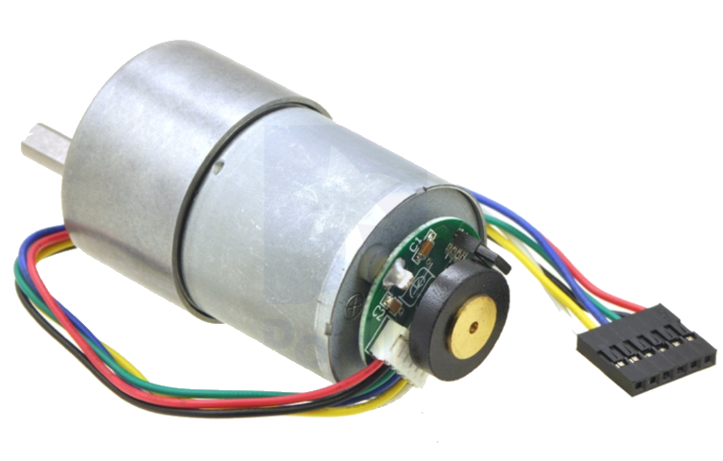
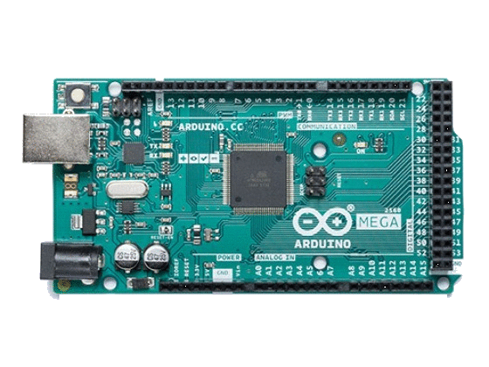
Important Components Used
DC Motor with Encoder, for the component being analyzed, as well as the method of feedback to use during position control
Arduino Mega, to handle all power allocation, encoder feedback, and logic

Slide 3
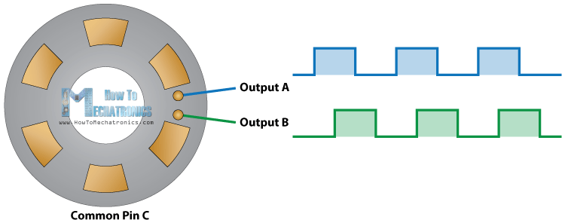
Motor Encoder

Slide 4
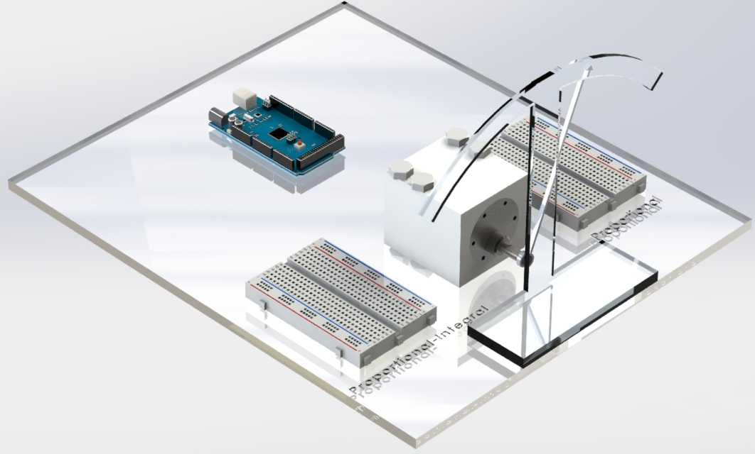
The Build:
Initial Concept Vs Final Design
Initial Design: Finished Product:

Slide 5
Trial
&
Error
Logic
Timed Sampling
Interrupts
Wiring and Organization

Slide 6
Expected Controller Response
P-Control
Faster response
Steady-state error
PI-Control
Slower response
Negligible steady-state error

Slide 7
Further Development
Start at “home” position
Experiment with D-Control
Make it battery compatible, for robot application
Consolidate the design onto a circuit board

